Slide 1
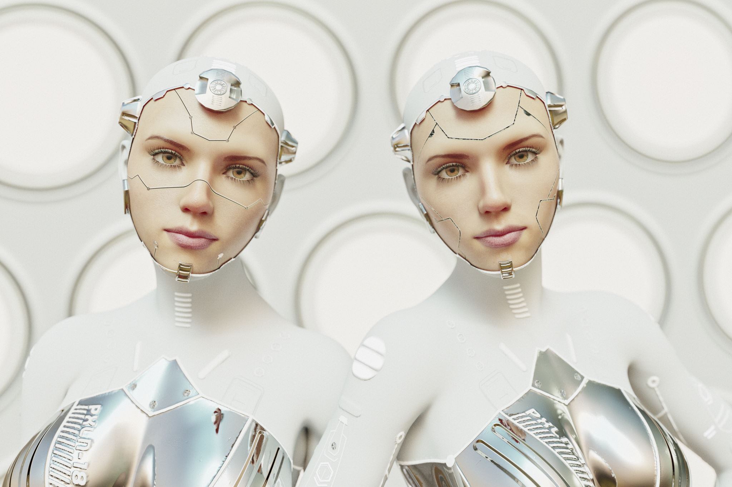
Face Reconition for Limited Resources Devices Computer Vision By Alvaro Cervan Canton, Lucerne University of Applied Sciences and Arts, 2025
Notes:
Good afternoon Umberto, Now I will present my computer vision Project about face recognition models implemented in limited resourced devices

Slide 2
Outline
Definition, motivation and goals
Datasets
Models and performance
Evaluation:
Classification
Validation 1:1
Conclusion
Face ID demo App
Q&A

Slide 3
What is Face Recognition?
Fundamental task in computer vision in which a model is capable to identify a face on an image and determine their identity by classification or comparison.
Diverse applications, such as: device unlock, surveillance, access control, social media tagging...
This project focuses on the face detection and comparison between images for security and log-in functions.
Deep learning, especially CNNs, have boosted face recognition accuracy by learning robust facial features. These models outperform older methods, even under poor lighting or angle variations.
Notes:
Face recognition is a computer visión task in which a model can identify faces on images or video. In this Project we will take this capability to compare images to each other to determine if the fase and person on the images are the same. This can be applied to unlocking devices, surveillance, secury log-in etc.
Deep learning models, specially convolutional neural networks have revolutionized the field by learning the most important facial features. This outperforms older models even if the image quality are por.

Slide 4
Project Objective and Motivation
Objective: To evaluate and compare various deep learning models for face classification and validation.
Dataset: Curated dataset of 18 faces, about 100 images each.
Goals: Understand performance, analyze generalization/overfitting and develop a reproducible evaluation framework.
Question: What are the options for less powerful devices like smartphones or laptops to use non-proprietary models (Apple or Microsoft) and implementations.
Notes:
The main objective of this project was to evaluate and compare various deep learning models for face classification and validation. This was performed using a curated dataset of 18 distinct faces, with approximately 100 images for each. The goals included understanding model performance, analyzing generalization and overfitting, and developing a reproducible evaluation framework.
This work is important as it provides insights into how transfer learning performs on smaller datasets, offering foundational knowledge for deployments on less powerful devices. Options for smartphones or laptops, specifically concerning non-proprietary models and implementations, were a key consideration within this evaluation.

Slide 5
The Datasets
Original Dataset
The dataset contains 17 celebrities (100 images each) from kaggle + the student images from a face scan video (300 images), totalling around 2000 images.
All images were pre-processed by using MTCNN for face detection, resizing, cropping (128x128) and normalization.
Augmentation
Images augmented in 3 different ways: Horizontal flip, slight rotation and color jitter
This created for each original images, 3 extra augmented, totalling 2000 x 4 = 8000 images
To avoid a previous data leakage, the Split is done 70% - 15% - 15% in a non-random way, making it deterministic and checking that all 4 images (original + 3 augmented) were in a single Split.
Notes:
datasets: - Original: The dataset contains 17 celebrities (100 images each) from kaggle + the student images from a face scan video (300 images), totalling around 2000 images. All images were pre-processed by using MTCNN for face detection, resizing, cropping (128x128) and normalization. - Augmented:Images augmented in 3 different ways: Horizontal flip, slight rotation and color jitter. This created for each original images, 3 extra augmented, totalling 2000 x 4 = 8000 images To avoid a previous data leakage, the Split is done 70% - 15% - 15% in a non-random way, making deterministic and checking that all 4 images (original + 3 augmented) were in a single Split.

Slide 6
Models
Classical Approaches:
PCA, LBP
Transfer Learning (CNN Baselines):
VGG16 base and fine-tuned, MobileNetV2
Embedding-Based (State-of-the-Art):
FaceNet, ArcFace (with KNN classifier)
Notes:
The evaluation encompassed three main categories of models for face recognition. Classical approaches, including PCA and LBP, provided a foundational baseline. Transfer learning was employed with Convolutional Neural Networks, specifically fine-tuning VGG16 and MobileNetV2. Additionally, state-of-the-art embedding-based models like FaceNet and ArcFace were utilized, with classification performed via K-Nearest Neighbors.

Slide 7
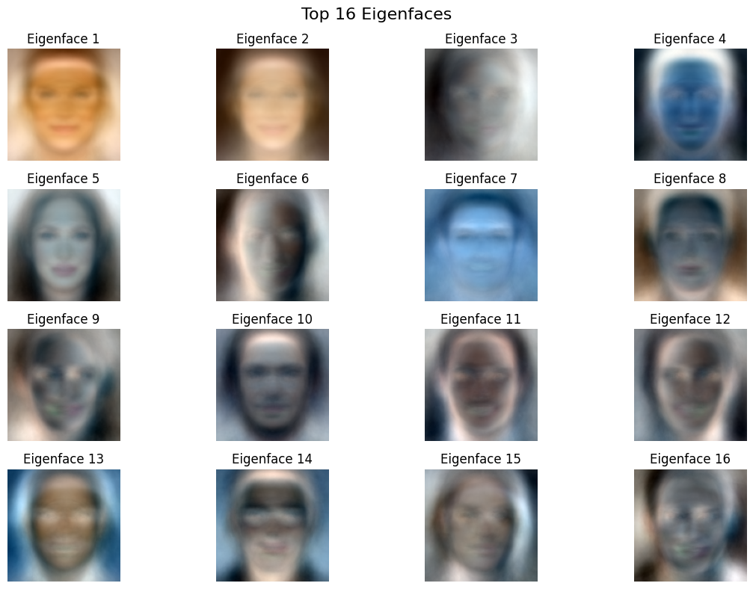
Models: Classical Approaches - PCA
PCA (Principal Component Analysis) reduces high-dimensional image data into the most important features (called principal components).
KNN (K-Nearest Neighbors) classifies a face by comparing it to the most similar examples in the training set.
Results:
Original Dataset:
Accuracy: 21.15% — struggled with class separation.
With Augmentation:
Accuracy: 44.34% — improved due to more diverse training samples.
Conclusion: PCA + KNN is simple and fast, but lacks the robustness of modern deep learning methods. Augmentation helps, but performance is still limited.
Notes:
This slide explains the use of PCA as a classical method for face recognition, paired with K-Nearest Neighbors for classification. PCA reduces each face image to its key visual features, while KNN compares these to known samples. On the original dataset, the model reached only 21% accuracy, suggesting weak separation between classes. Augmenting the data raised accuracy to 44%, showing that variety helps but isn't enough. Overall, this method is fast and simple but lacks the accuracy needed for reliable recognition in modern applications.

Slide 8
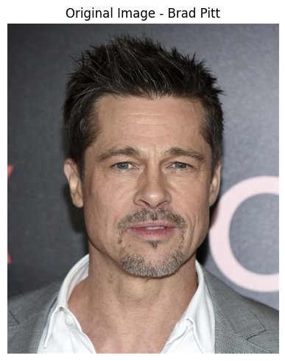

Models: Classical Approaches - LBP
LBP (Local Binary Patterns) captures multi-scale texture features from grayscale images by comparing neighboring pixel intensities.
SVM (Support Vector Machine) is trained on these features to classify identities.
Results:
Original Dataset:
Accuracy: 30.51%
With Augmentation:
Accuracy: 35.65%
Conclusion: LBP + SVM performs better than PCA in capturing local patterns but still underperforms in diverse conditions. Data augmentation gives a slight boost.
Notes:
Next, LBP plus SVM pipeline, a classical method combining hand-crafted texture features with a traditional classifier. LBP extracts patterns based on pixel intensity differences, allowing the model to detect local details across face images. The support vector machine then attempts to separate identities using these features. The approach outperforms PCA, achieving 30% accuracy on the original dataset, and slightly improves with data augmentation to around 36%. Still, the increase is modest, indicating that while LBP captures more facial structure than PCA, it struggles with variations in lighting, expression, or alignment. Overall, this method is somewhat more effective than PCA but remains limited for large-scale or diverse recognition tasks.

Slide 9
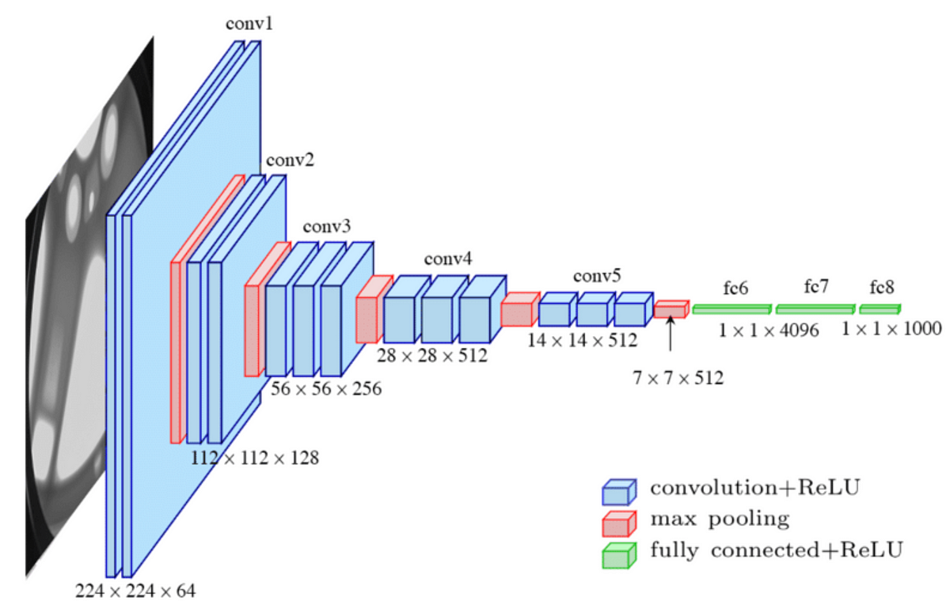
Models: Transfer Learning – VGG16 Base
Loads VGG16 pre-trained on ImageNet, cuts off the classifier (include_top=False).
Freezes the entire convolutional base, it won’t update weights but provides faster training.
Adds a simple custom head:
GlobalAveragePooling2D: collapses spatial dimensions → reduces overfitting, fewer params.
Dense(256, relu) and Dropout(0.5): classic dense head.
Final classification with Dense(num_classes, softmax).
Results (Accuracy):
Original Dataset: 43.8%
Augmented: 66.84%
Conclusion: Outperforms classical PCA and LBP methods, leverages deep, hierarchical features and is well-suited for complex visual patterns in faces.
Notes:
This model builds on the VGG16 architecture pre-trained on ImageNet, the convolutional base is kept frozen during training to preserve its learned representations and accelerate convergence. A custom classification head is added, starting with a Global Average Pooling layer to reduce spatial dimensions and mitigate overfitting. This is followed by a dense layer with 256 neurons activated by ReLU, a Dropout layer to encourage regularization, and a final softmax output matching the number of identity classes. The model achieved 43.8% accuracy on the original dataset, which improved to 66.8% with augmented data. This demonstrates stronger performance than traditional approaches like PCA or LBP, due to VGG16’s capacity to extract robust and hierarchical facial features.

Slide 10
Models: Transfer Learning – Custom VGG16 (finetuned)
First 10 layers frozen (general features), others fine-tuned for face-specific patterns
Batch Normalization: Added after pooling & Dense layers — stabilizes training, improves convergence.
Dropout (0.4 × 2) Reduces overfitting, complements BatchNorm for robust generalization.
Callbacks: Early Stopping + Reduce Learning Rate on Plateau dynamically adjust training to preserve best weights.
Results (Accuracy):
Original Dataset: 82.17%
Augmented: 93.81%
Conclusion: Finetuned model clearly outperforms the base model, shows significant improvement by the augmented dataset but has slower training. A scalable and accurate solution for face recognition in real-world scenarios.
Notes:
This approach uses the VGG16 model with partial fine-tuning to adapt it more specifically to the facial recognition task. The first ten layers are frozen to retain generic visual features, while the remaining layers are retrained to capture identity-specific patterns. Batch normalization is inserted after pooling and dense layers, stabilizing gradient flow and accelerating training. Two dropout layers with a 40% rate are used to prevent overfitting, especially when combined with batch normalization. The training process includes dynamic control through callbacks: early stopping halts training when progress stalls, and the learning rate is reduced when improvement plateaus, helping to fine-tune the model efficiently. Performance reaches 82.2% accuracy on the original dataset and climbs to 93.8% with augmentation. This makes the model highly accurate, but slightly more computationally demanding. [[[Model layers shown using https://netron.app/]]]

Slide 11
Models: Transfer Learning – MobileNetV2
Lightweight, efficient CNN optimized for speed and performance, ideal for small devices
Features:
Partial Unfreezing: First 20 layers frozen → preserves low-level features
Fine-tuning deeper layers: Adapts MobileNetV2 to facial identity recognition
Batch Normalization: Added after pooling and dense layer
Dropout (0.3 × 2): Regularizes and prevents overfitting
Mixed Precision Enabled: Faster training, reduced memory usage
Callbacks: Early Stopping and RLRPlateau.
Results (Accuracy):
Original Dataset: 67.37%
Augmented: 84.29%
Conclusion: Fine-tuned MobileNetV2 balances performance and efficiency well fitted for mobile face recognition applications. Less performant tan VGG16 but faster to train.
Notes:
This model adapts MobileNetV2, a lightweight network built for mobile devices. The lower 20 layers are frozen to preserve basic visual features, while the rest are fine-tuned to learn face-specific patterns. Batch normalization and two dropout layers are added to enhance generalization. Mixed-precision training helps reduce memory usage and speed up training. The model achieves 67.4% accuracy on the original dataset and 84.3% on the augmented one. Though less accurate than VGG16 but provides faster and more efficient training.

Slide 12
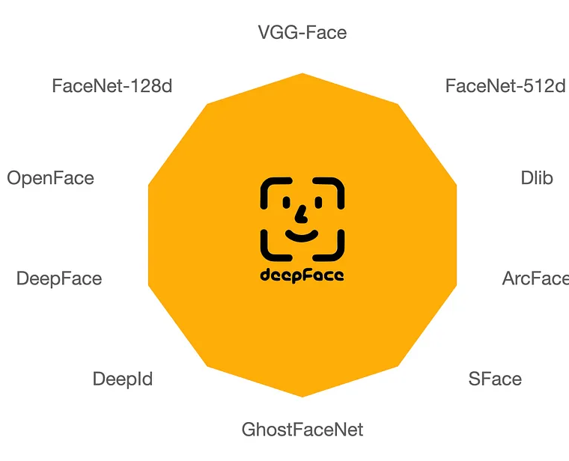
Models: Embedding Based – FaceNet (Google)
Uses DeepFace library to implement and to extract high-quality FaceNet embeddings.
Face Embeddings: Pre-trained FaceNet generates identity-aware descriptors
learns a 128D vector for each face → optimized for identity separation
KNN classifier (k=1) used on embeddings for final recognition
Embedding-to-embedding comparison (Euclidean distance)
No retraining needed: Embeddings computed once → fast and memory-efficient
Results: Original dataset 88.18%
Notes:
This approach uses the DeepFace framework to access pre-trained FaceNet embeddings, which convert each facial image into a compact 128-dimensional feature vector. These embeddings are optimized to maximize identity separation, making them suitable for face comparison tasks. Once embeddings are generated, a simple k-Nearest Neighbors classifier with k=1 is applied to identify faces by comparing distances between vectors. Since embedding extraction is precomputed, the pipeline runs quickly and with low memory demand, making it efficient for deployment. On the original dataset, this method achieved 88.2% accuracy, showing strong performance without the need for model retraining.

Slide 13
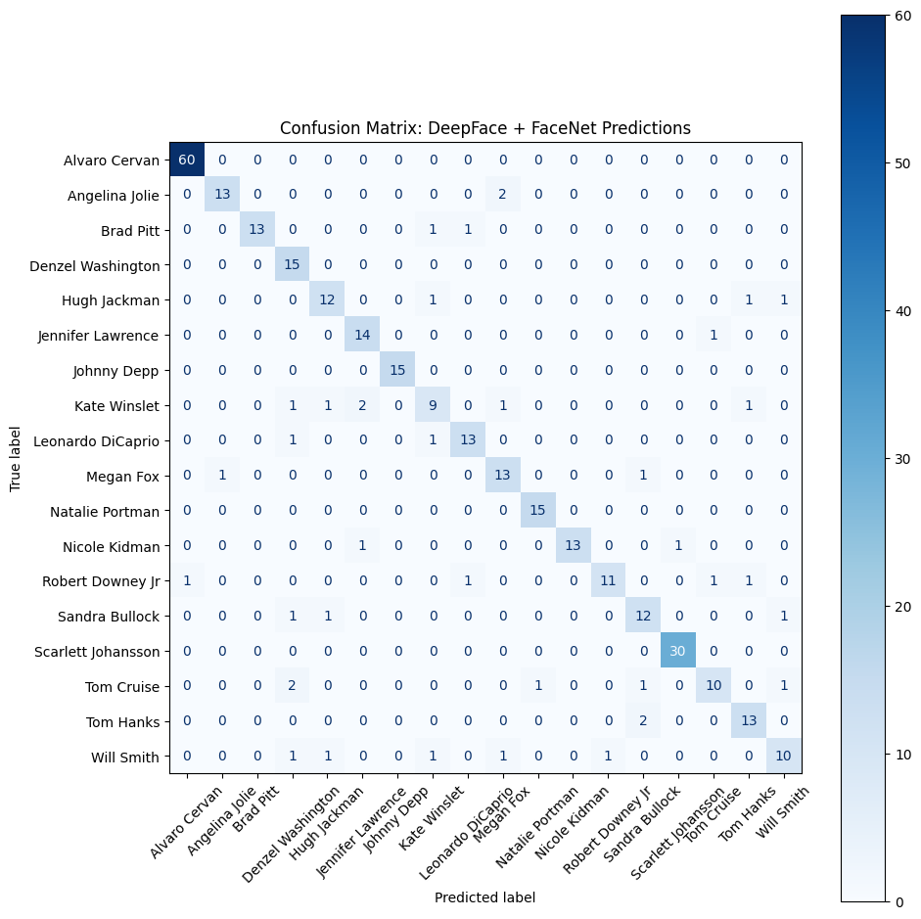
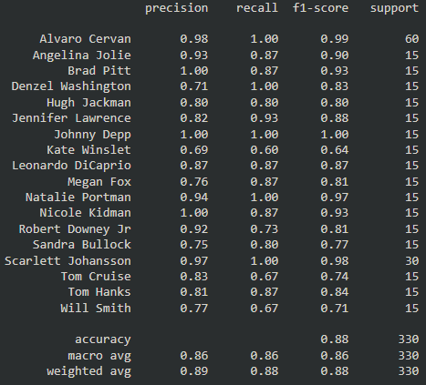
FaceNet Matrix
Noticeable F1 scores for Johnny Deep, Alvaro or Scarlet Johansson for a near 100% score.
Worst performers were Kate Winslet and Wills Smith
Facenet Evaluation scores per class (actor name)
Notes:
The model perfectly classified identities like Johnny Depp, Alvaro Cervan, and Scarlett Johansson, showing highly distinctive embeddings. In contrast, Kate Winslet and Will Smith had lower accuracy, likely due to greater visual overlap or variation in their images.

Slide 14
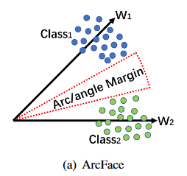
Models: Embedding Based – ArcFace
Uses ArcFace (buffalo_l) from InsightFace with RetinaFace for face detection and Additive Angular Margin Loss, which improves identity separation by enforcing angular boundaries between classes on a hypersphere
Embeddings are 512-dimensional and extracted per aligned face.
Classification is done using KNN with Euclidean distance. No model training is needed.
If no face is detected, a zero-vector is assigned. Ensures robustness and avoids pipeline failure.
Results: Original dataset 91.81%
Notes:
This model uses the ArcFace architecture with a RetinaFace detector to generate 512-dimensional embeddings for each aligned face. Images are resized and passed through the pre-trained network without additional training. Classification is performed using 1-nearest neighbor over a reference set built from training and validation embeddings. If detection fails, a fallback zero-vector ensures stability. This retrieval-based method reached 91.8% accuracy on the original dataset.

Slide 15
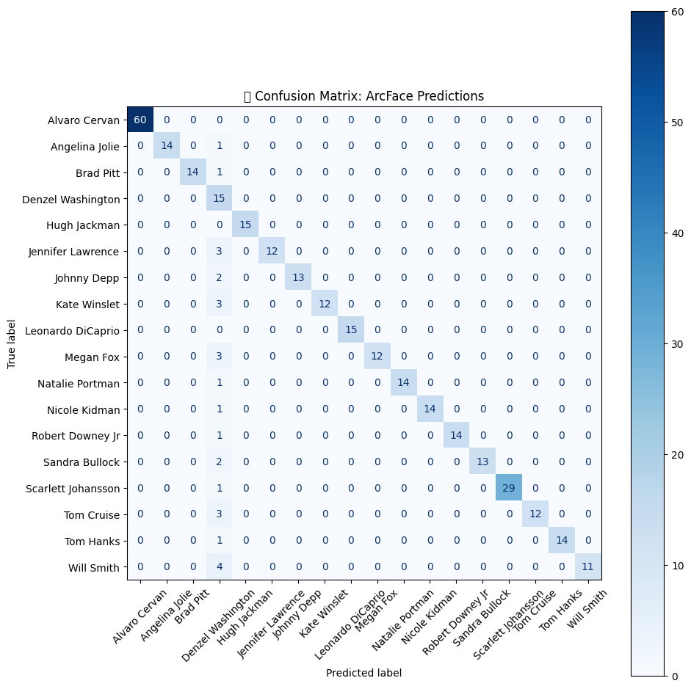
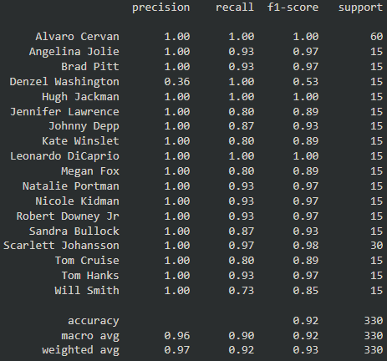
ArcFace Matrix
Precision noticeably better compared to FaceNet, outlier Denzel Washington.
Several identities achieve perfect precision and recall
Fast, accurate, and training-free approach
ArcFace Evaluation scores per class (actor name)
Notes:
ArcFace delivers superior precision, outperforming FaceNet on several identities with perfect scores. The model combines speed and accuracy with an efficient, training-free design.

Slide 16
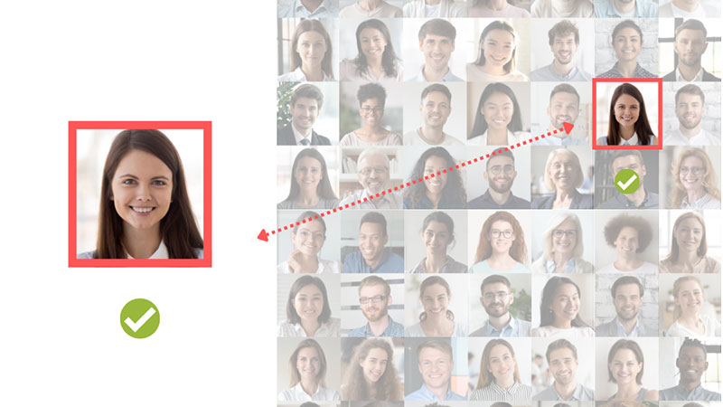
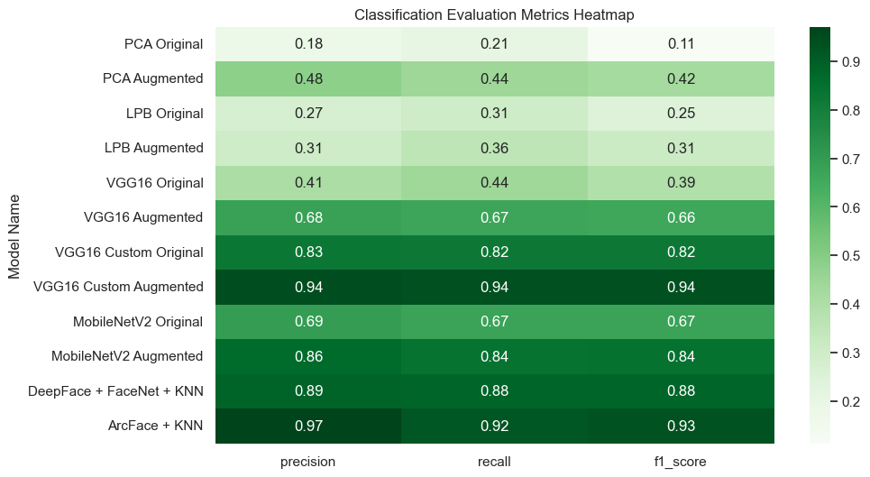
Evaluation - Classification
Images on the test set are assigned a class that can be correct or incorrect.
Useful to decide if an image (user login) matches any of the registered identities. The user must be on the model when trained.
Evaluation metrics are:
Accuracy: % of correct predictions.
Precision: % of predicted positives that are correct.
Recall: % of actual positives correctly predicted.
F1-Score: Balance between precision and recall.
Notes:
Now we evaluate the models: First, Classification evaluation measures how well the model can assign test images to known identities. It’s a closed-set classification task, meaning all test images belong to classes seen during training. The goal is to determine whether a new image, such as for login, correctly matches a registered identity. Performance is assessed using accuracy, precision, recall, and F1-score — offering insight into overall correctness, prediction reliability, detection completeness, and balance between the two.

Slide 17
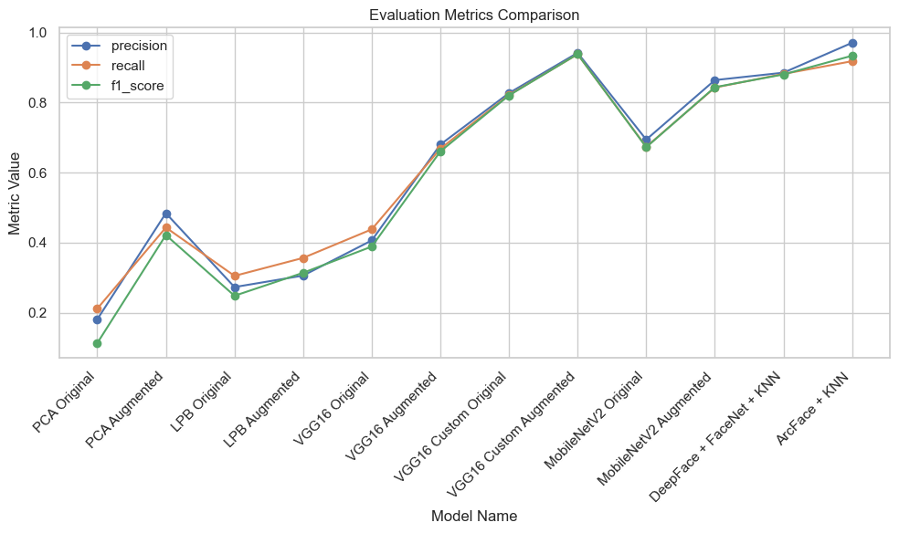
Evaluation - Classification - Comparison
Best models: VGG16 Custom trained on Augmented dataset and ArcFace, followed by DeepFace and MobileNetV2 trained on Augmented.
Worst performers: the Classical Approaches: PCA, LBP
Best models achieve F1_scores above 0.88, indicating strong and consistent prediction quality
CNN models outperform Classical ones even after augmentation, highlighting their limitations.
Notes:
This comparison highlights the superiority of deep learning models over classical approaches in face classification. The highest F1-scores were achieved by VGG16 Custom with data augmentation and ArcFace, followed closely by DeepFace and MobileNetV2 with augmentation. All top models scores exceeded 0.8, reflecting strong and consistent predictions. In contrast, PCA and LBP delivered the weakest results, even after augmentation, confirming that classical techniques struggle to compete with CNN-based methods in complex recognition tasks.

Slide 18
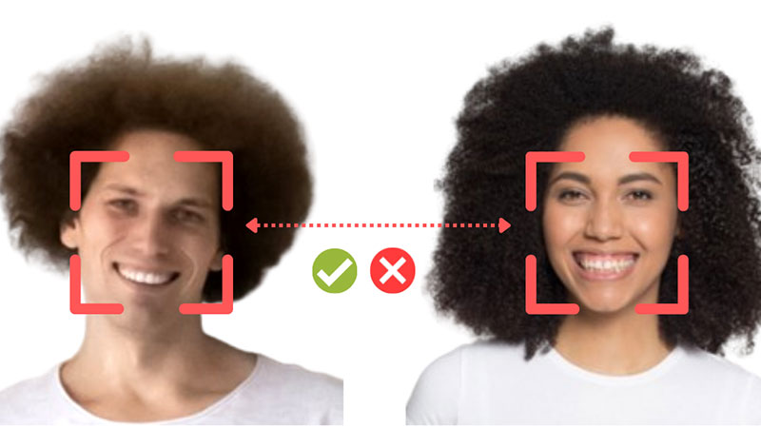
Evaluation – Validation 1:1
Measure whether two face images belong to the same person, regardless of their class label.
Used for open-set matching (compare user of the device with their identity on database)
Each image is passed through an embedding model -> numerical descriptor.
Compute pairwise distances (KNN)
Label each pair as Match or non-Match
The results are compared to their correct labels and claculate the metrics:
AUC (Area Under Curve): overall ranking performance.
EER (Equal Error Rate): the point where false acceptance = false rejection.
Notes:
Second, Validation 1 on 1. This verification task checks whether two face images belong to the same individual, regardless of class. It’s useful for open-set scenarios like user authentication. Each image is converted into an embedding, and distances between pairs are measured. A match or non-match label is assigned based on thresholding. Performance is evaluated using AUC to assess ranking ability and EER to identify the balance point between acceptance and rejection errors.

Slide 19
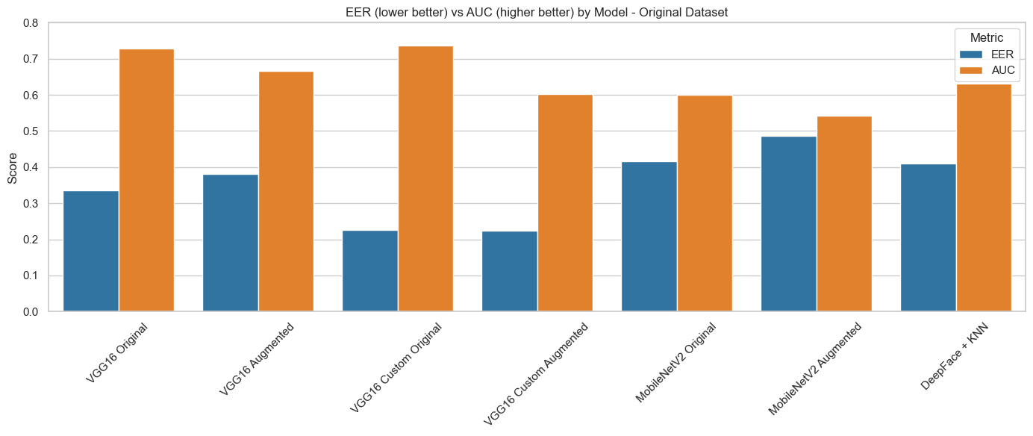
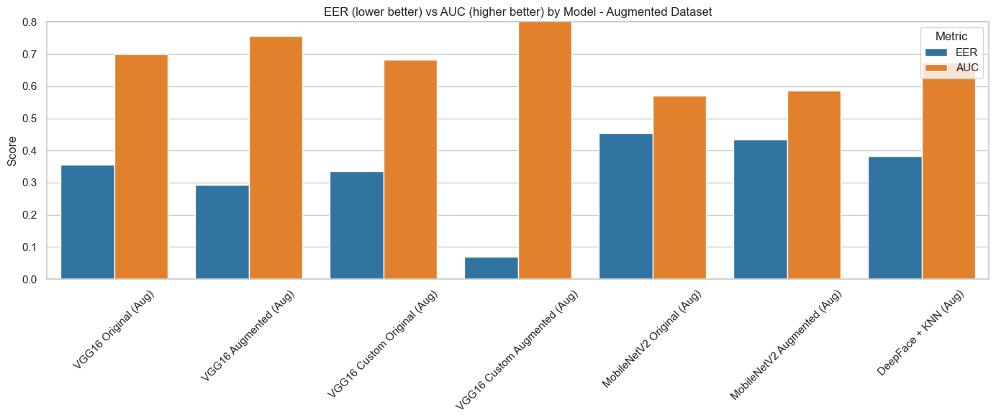
Evaluation – Validation 1:1 – Comparison
Custom VGG16 with augmentation produces the most reliable embeddings for identity verification.
Data augmentation significantly boosts verification accuracy when also used during training.
Fine-tuning improves embedding quality, especially for CNN-based models like VGG16.
MobileNetV2 and DeepFace models show limited generalization, underperforming across test sets.
Verification accuracy depends heavily on consistency between training and test distributions. (Real vs Verified face)
ArcFace failed to generate valid embeddings in this test due to dependency issues (excluded from conclusions).
Notes:
The custom VGG16 model with data augmentation delivers the most consistent and accurate results, thanks to high-quality embeddings and fine-tuning. Augmentation proves especially valuable when applied both during training and validation, increasing generalization. MobileNetV2 and DeepFace, while efficient, show limited adaptability across different conditions. Their performance drops when the test images differ noticeably from the training distribution, such as real-world versus verified face captures. ArcFace could not be included in this evaluation due to technical issues with embedding generation.

Slide 20
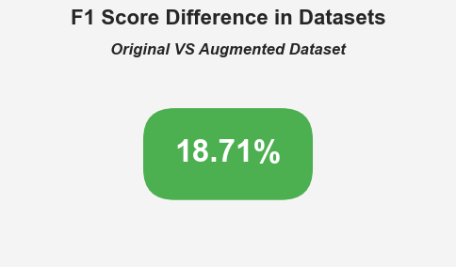
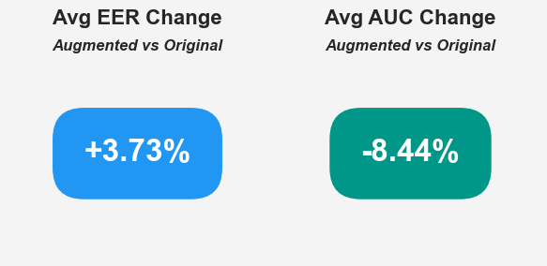
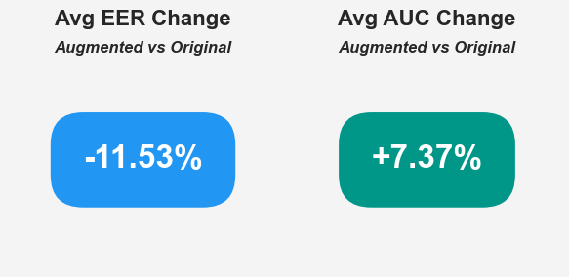
Does Data Augmentation matter?
Classification
Augmentation increases F1-score in classification by almost 19%.
In validation, depends wether the models were trained with original data (worse results) or also with augmented data (noticeable improvement)
Augmentation is critical for improving classification accuracy across all architectures.
For validation, augmentation must be mirrored in both training and evaluation to be effective.
Best results come from combining augmentation and fine-tuning, as seen in VGG16 Custom Augmented.
Embedding-based pipelines are highly sensitive to image distribution — augmentation must be controlled and consistent.
Validation Original Data
Validation Augmented
EER (Lower is Better)
AUC (Higher is Better)
Notes:
So, Does Data Augmentation Matter? - Absolutely. Augmentation boosts classification F1-scores by nearly 19%, improving accuracy across all models. It's most effective when combined with fine-tuning, as shown in the Custom VGG16 results.For validation, its impact depends on consistent use across training and testing. When mismatched, performance drops — especially in embedding-based models that are sensitive to data distribution. Controlled and mirrored augmentation leads to the most reliable outcomes.

Slide 21
Conclusions
Custom fine-tuned CNNs, especially VGG16 and MobileNetV2, deliver the strongest performance across both classification and verification tasks when trained on augmented data.
Embedding-based pipelines (ArcFace, FaceNet + KNN) are also highly effective, particularly in classification — but rely on clean, consistent input data and may struggle with verification if embeddings are misaligned.
Traditional methods (PCA, LBP) perform significantly worse, even with augmentation, and are not suitable for high-accuracy recognition.
Augmentation generally improves significantly a CNN model capabilities.
Notes:
Fine-tuned CNN models like VGG16 and MobileNetV2, especially when trained on augmented data, show the highest accuracy for both classification and verification tasks. Embedding-based methods (ArcFace, FaceNet + KNN) also perform strongly—particularly in classification—but depend on clean, consistent inputs and can falter in verification if embeddings are poorly aligned. In contrast, traditional techniques such as PCA and LBP lag behind, even with augmentation, and are inadequate for high-accuracy face recognition. Overall, data augmentation significantly enhances CNN performance and is a key component for achieving robust, reliable results.

Slide 22

Conclusion 2
All top-performing models used in this project are publicly available and open source, making them accessible to developers and researchers without proprietary restrictions.
With proper input alignment, light preprocessing, and dataset-specific fine-tuning, these models can rival commercial solutions for many use cases — such as attendance tracking, personal security, or identity validation.
Final performance and deployment depend not just on model choice but also on pipeline design, preprocessing consistency, domain adaptation and specific target device.
Notes:
All top-performing models used are open source, making them easy to adopt without licensing constraints. With proper preprocessing and task-specific tuning, they can match commercial solutions in real-world uses like security or ID checks. Still, success depends on more than model choice—it requires consistent pipelines, domain adaptation, and optimization for the target device.

Slide 23

Target to Devices (phone and laptop image)
With the best performing models, now it is time to take into account other factors:
The easiest way to implement is DeepFace library with FaceNet.
Fastest training was from MobileNetV2.
Best option: FaceNet implemented with DeepFace, provides one of the strongest performances with no training time. Embedding extraction is fast.
Devices could come with the model pre-downloaded, only calculation on device would be embedding extraction with optional image augmentation.
Viable option for Android pones, laptops, Linux distributions etc.
Notes:
FaceNet via DeepFace is the best option: high accuracy, no training time, and fast embedding extraction. MobileNetV2 trains quickly but needs more setup. Classical models are excluded due to low performance.
For real-world use, devices like Android phones, laptops, and Linux systems can ship with the model preloaded. At runtime, only embedding extraction (and optional augmentation) is needed — making this setup lightweight, fast, and ideal for on-device face recognition.

Slide 24

Demo – Log in with Face Recognition
Notes:
And now a demonstration on how it can be implemented with streamlit as a fase ID login system

Slide 25

Q&A
Thank you for listening
Any questions?
Notes:
Thank you for listening, I will be happy now to answer any questions

